Slide 1
Tutorial 10: Memoization and Dynamic Programming
16th May

Slide 2
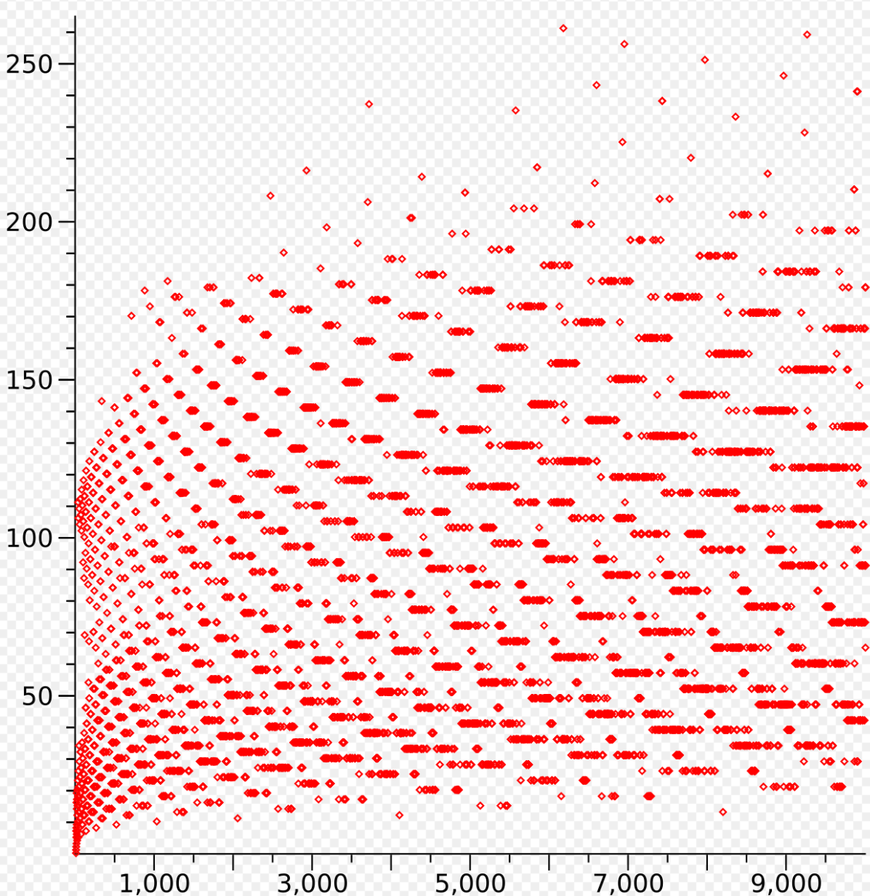
Background: Collatz Distance
Collatz Conjecture has not been proven (unsolved problem)
If distance(k) = ∞ for infinitely many k, there is no upper bound for time complexity
In general: each odd number is ¼ smaller than the last one
Recursive statement for time: T(n) = T(3n/4) + O(1) → O(log n) for most values of n
Collatz distance for 1 to 10,000:

Slide 3
Q1 (a): Question Analysis
What is the key information?
How do we implement the Collatz function?
How do we count the number of steps?

Slide 4
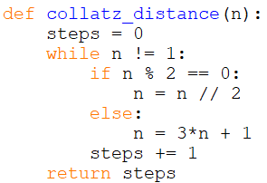
Q1 (a): Answer
Iteration
Time complexity: O(log n) for most values of n
Space complexity: O(1)

Slide 5
Q1 (a): Answer
Recursion
Time complexity: O(log n) for most values of n
Space complexity: O(log n)

Slide 6
Q1 (b): Question Analysis
What is the key information?
How do we get the max distance over a range of numbers?

Slide 7
Q1 (b): Answer
Iterative solution
Time complexity: O(n log n)
Space complexity: O(1)

Slide 8
Q1 (b): Answer
Recursive solution
Time complexity: O(n log n)
Space complexity: O(n)

Slide 9
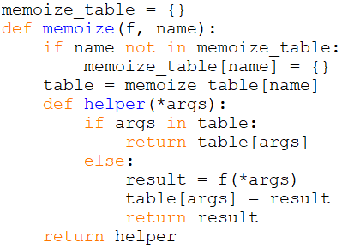
Q1 (c): Question Analysis

Slide 10
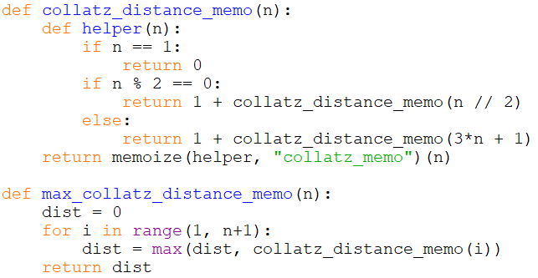
Q1 (c): Answer
Follow the steps in lecture video
Wrap original function
Rename recursive calls
Add outer return call

Slide 11
Q1 (d): Question Analysis
What is the key information?
Which parts of max_collatz_distance is memoizable?

Slide 12
Q1 (d): Question Analysis
1
2 | 1
3 | 10 | 5 | 16 | 8 | 4 | 2 | 1
4 | 2 | 1
5 | 16 | 8 | 4 | 2 | 1
Collatz_distance creates overlapping subproblems (highlighted in yellow)

Slide 13
Q1 (d): Question Analysis
State:
Current value of n
How states are related:
Odd-even rule tells us which state to go to next
Base case:
collatz_distance(1) = 0

Slide 14
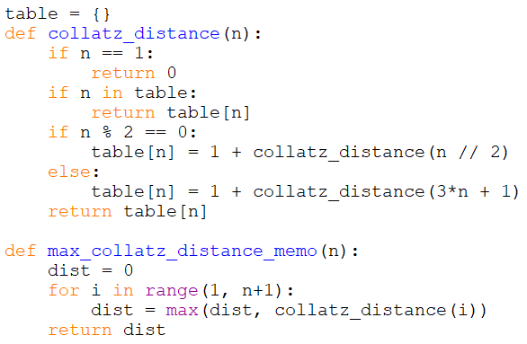
Q1 (d): Answer
Top-down memoization
Distance computed only when needed
Same distance requested: return value stored in table instead
Time complexity: O(n)
Space complexity: O(n)
O(1) time on average to go from n → 3n/4

Slide 15
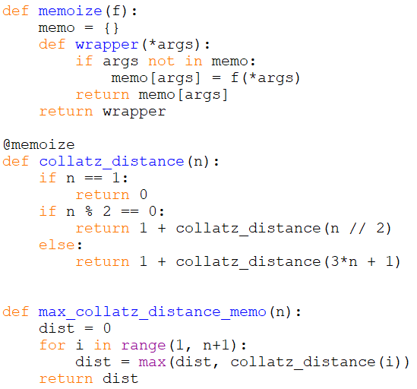
Q1 (d): Alternate answer
Decorators (not in syllabus)
Functions that extend/modify behaviour of other functions
@decorator_name before function definition
No change to solution from 1(b)!

Slide 16
More on Dynamic Programming after Q2, as it is the more important topic for this tutorial

Slide 17
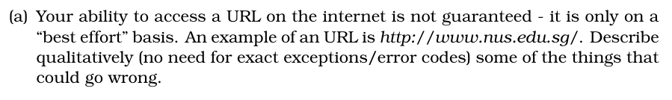
Q2 (a): Question Analysis

Slide 18
Q2 (a): Answer
(Non-exhaustive)
Internet goes down
Server hosting the website goes down
Domain Name System (DNS) name server down
DNS translates human-readable addresses into Internet Protocol (IP) addresses
HTTP error codes
4xx: Error caused by client
5xx: Error caused by server
https://en.wikipedia.org/wiki/List_of_HTTP_status_codes

Slide 19
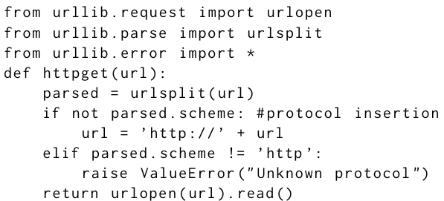
Q2 (b): Question Analysis

Slide 20
Q2 (b): Answer
Possible for the webpage content to be empty string or “Not Found”
Errors can give us more detailed information on what went wrong

Slide 21
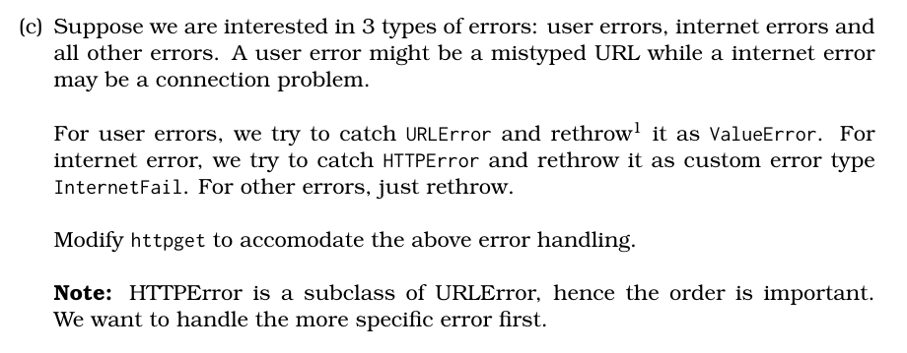
Q2 (c): Question Analysis
What is the key information?
How do we catch and throw errors?
What order should we handle errors?

Slide 22
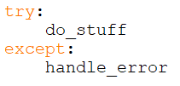
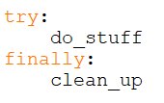
Q2 (c): Error Handling
try: Section of code that is prone to errors
except: Code that runs if an exception is thrown
else: Code that runs only if there was no error in try
finally: Code that always runs even if there was an error
Basic structure:

Slide 23
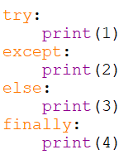
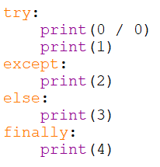
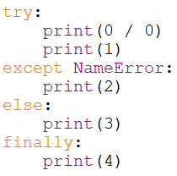
Q2 (c): Error Handling
1, 3, 4
2, 4
4
ZeroDivisionError

Slide 24
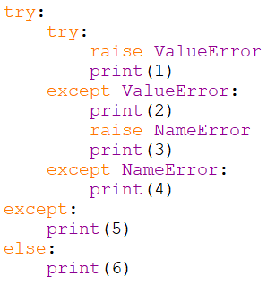
Q2 (c): Error Handling
Output: 2, 5
Try-except statements can be nested
Except only catches errors from the try block
Errors that are not caught are thrown outwards

Slide 25
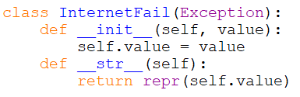
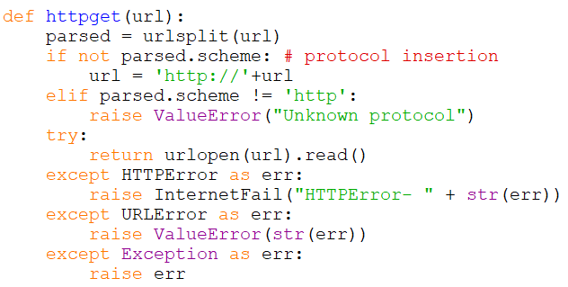
Q2 (c): Answer
Handle subclass (HTTPError) before superclass (URLError)
str(err): get error message

Slide 26
Q2 (d): Question Analysis
What is the key information?
Writing to files
Catching multiple errors together

Slide 27
Q2 (d): Answer

Slide 28
The End

Slide 29
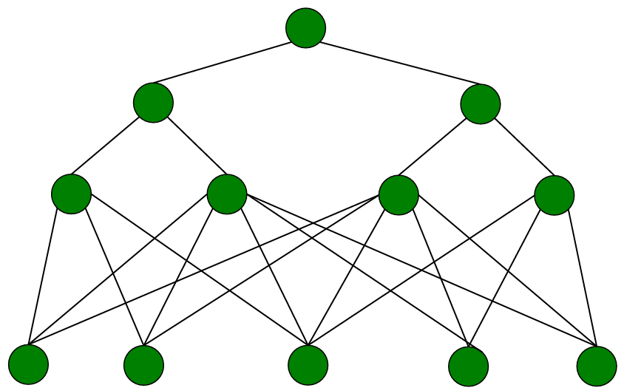
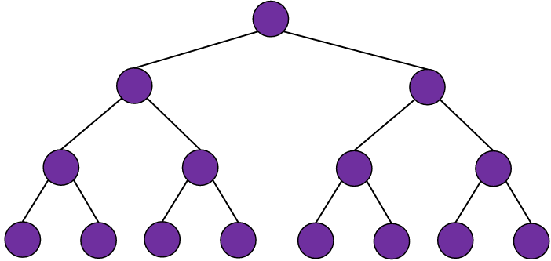
Dynamic Programming
Key idea: overlapping subproblems
Less time: avoid recomputing answers to the same subproblem
More space: store and return computed answers instead
Examples of dynamic programming:
Fibonacci, count change, collatz distance
Merge sort, quick sort: Divide and conquer

Slide 30
Dynamic Programming
Bottom up
Start from base case
Use smaller problems to solve larger problems
Common features: iteration, tables and lists
Top down
Start from main problem
Recurse into smaller problems until base case
Common features: recursion, dictionary and hash table

Slide 31
Dynamic Programming
State: How to create subproblems? What are the inputs? What does the output represent?
How states are related: What is the recurrence relation? State calls smaller subproblems based only on its inputs Calling the same state should return the same output
Base case: Initialise DP table or stop making new recursive calls
Target: The target state to compute and solve original problem

Slide 32
Extra Problem 1
Choose numbers from a list such that the sum of numbers is the highest and no two chosen numbers are adjacent.
Example:
1 | 5 | 3 | 4 | 5
1 | 5 | 3 | 4 | 5
mySum([1, 5, 3, 4, 5]) → 5 + 5 = 10

Slide 33
Ex 1: Question Analysis
State:
F(i) → max sum of numbers from 1 to i → mySum(list[:i])
How states are related:
If list[i] is not part of the sum, mySum(list[:i]) == mySum(list[:i-1])
If list[i] is part of the sum, mySum(list[:i]) = mySum(list[:i-2]) + list[i]
→ F(i) = max(F(i-1), F(i-2) + list[i])
Base case:
F(-1) = 0 or F(0) = list[0]
F(0) = list[0] F(1) = max(list[0], list[1])
Target:
F(n) == mySum(list)

Slide 34
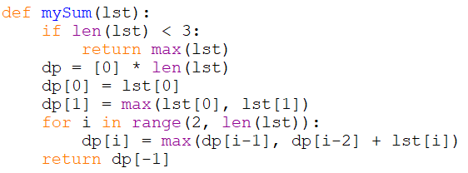
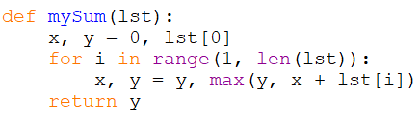
Ex 1: Bottom-up solution
Ver. 1
Time: O(n)
Space: O(n)
Ver. 2
Time: O(n)
Space: O(1)

Slide 35
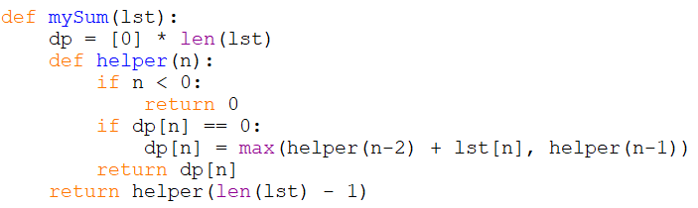
Ex 1: Top-down solution
Time: O(n)
Space: O(n)
Time and space usually proportional to number of cases

Slide 36
Extra Problem 2: Knapsack
 | 1 | 2 | 3 | 4
Value | 5 | 4 | 3 | 2
Weight | 4 | 3 | 2 | 1
Given n items and a bag with capacity W, find the maximum total value that can be put into the bag.
W = 6, output = 9 (choose items 2, 3, 4)

Slide 37
Ex 2: Naïve Solution
Iterate through every possible combination of items
Track the max value of combinations that meet the weight limit
Time: O(2^n)

Slide 38
Ex 2: Problem Analysis
How to create smaller problems?
Key question: is item k in the list of selected items?
Yes → Solve problem excluding item k, target weight = weight - w[k]
No → Solve problem excluding item k, same target weight

Slide 39
Ex 2: Problem Analysis
State: Knapsack(i, w): max value considering up to i^{th} item, weight up to w
Relation: Knapsack(i, w) = max(Knapsack(i-1, w), Knapsack(i-1, w-Weight[i]) + Value[i])
Base case: Knapsack(0, w) = 0 Knapsack(i, 0) = 0
Target: Knapsack(n, W)

Slide 40
Ex 2: Using DP
item | 1 | 2 | 3
Value | 1 | 2 | 3
Weight | 3 | 4 | 1
n = 3, W = 4
item
weight | 0 | 1 | 2 | 3
0 | 0 | 0 | 0 | 0
1 | 0
2 | 0
3 | 0
4 | 0

Slide 41
Ex 2: Using DP
item | 1 | 2 | 3
Value | 1 | 2 | 3
Weight | 3 | 4 | 1
n = 3, W = 4
item
weight | 0 | 1 | 2 | 3
0 | 0 | 0 | 0 | 0
1 | 0 | 0
2 | 0 | 0
3 | 0 | 1
4 | 0 | 1

Slide 42
Ex 2: Using DP
item | 1 | 2 | 3
Value | 1 | 2 | 3
Weight | 3 | 4 | 1
n = 3, W = 4
item
weight | 0 | 1 | 2 | 3
0 | 0 | 0 | 0 | 0
1 | 0 | 0 | 0
2 | 0 | 0 | 0
3 | 0 | 1 | 1
4 | 0 | 1 | 2

Slide 43
Ex 2: Using DP
item | 1 | 2 | 3
Value | 1 | 2 | 3
Weight | 3 | 4 | 1
n = 3, W = 4
item
weight | 0 | 1 | 2 | 3
0 | 0 | 0 | 0 | 0
1 | 0 | 0 | 0 | 3
2 | 0 | 0 | 0 | 3
3 | 0 | 1 | 1 | 3
4 | 0 | 1 | 2 | 4

Slide 44
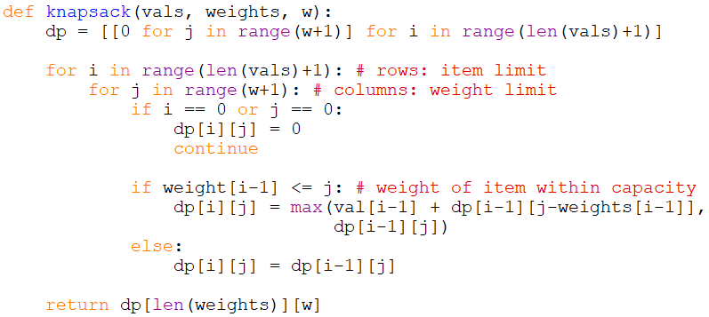
Ex 2: Bottom-up Solution
Time: O(nW)
Space: O(nW)
Challenge: O(W) space?

Slide 45
Ex 2: Top-down Solution
Time: O(nW)
Space: O(nW)

Slide 46
Bonus
Dynamic Programming - LeetCode

